Slide 1

Twitter Interface
Ngô Sỹ Tùng Lâm
Trần Trọng Khánh
Tô Minh Sơn

Slide 2

Contents
Introduction
Review
Architecture
Activities
Optimization
Demo
Conclusion

Slide 3
Introduction - Twitter
Definition: a social networking and microblogging service.
Task: allows users to answer the question, "What are you doing?“.
Method: sending short text messages 140 characters in length, called "tweets", to users friends, or "followers."

Slide 4
Introduction – Group project
What are we going to do:
A simple twitter user interface
User can sign in/ sign up
User can view timelines/ notifications
User can compose new tweet

Slide 5
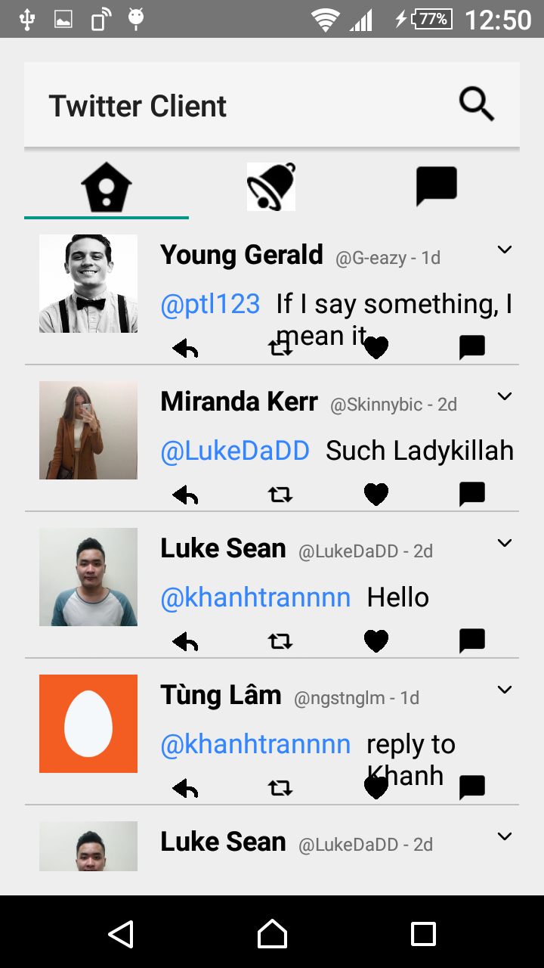
Review – What we did last time
Simple twitter client interface
Static information
2 main activities:
Log in
View home/notification/message

Slide 6
We want to implement some Twitter basic functions such as compose tweet, like or retweet,…
We used Fabric – An Support Development Kit which utilize Twitter API to do our task

Slide 7
Architecture
3 main activities:
Log in
Twitter activity
Composing new tweet

Slide 8
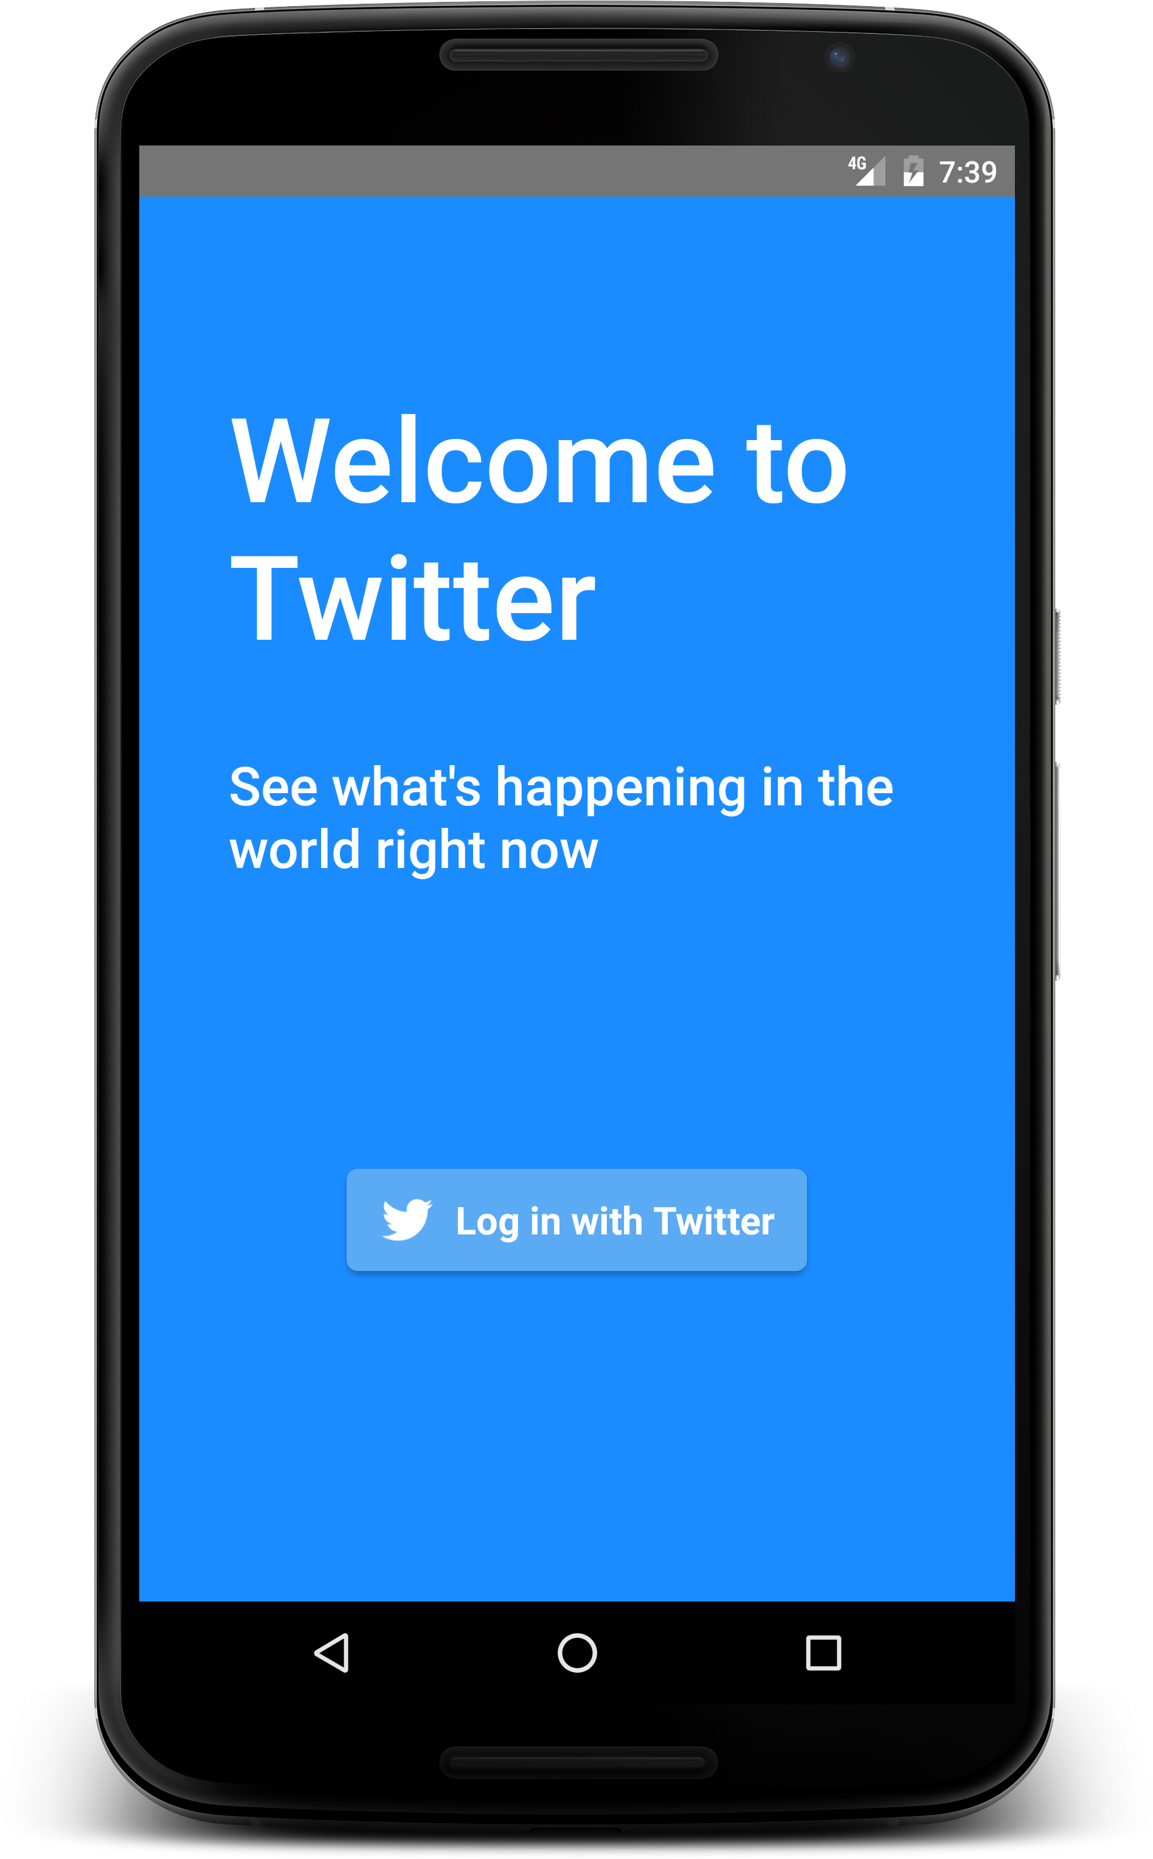
Log In Activity
A welcome page shows up
Press the login button to continue

Slide 9
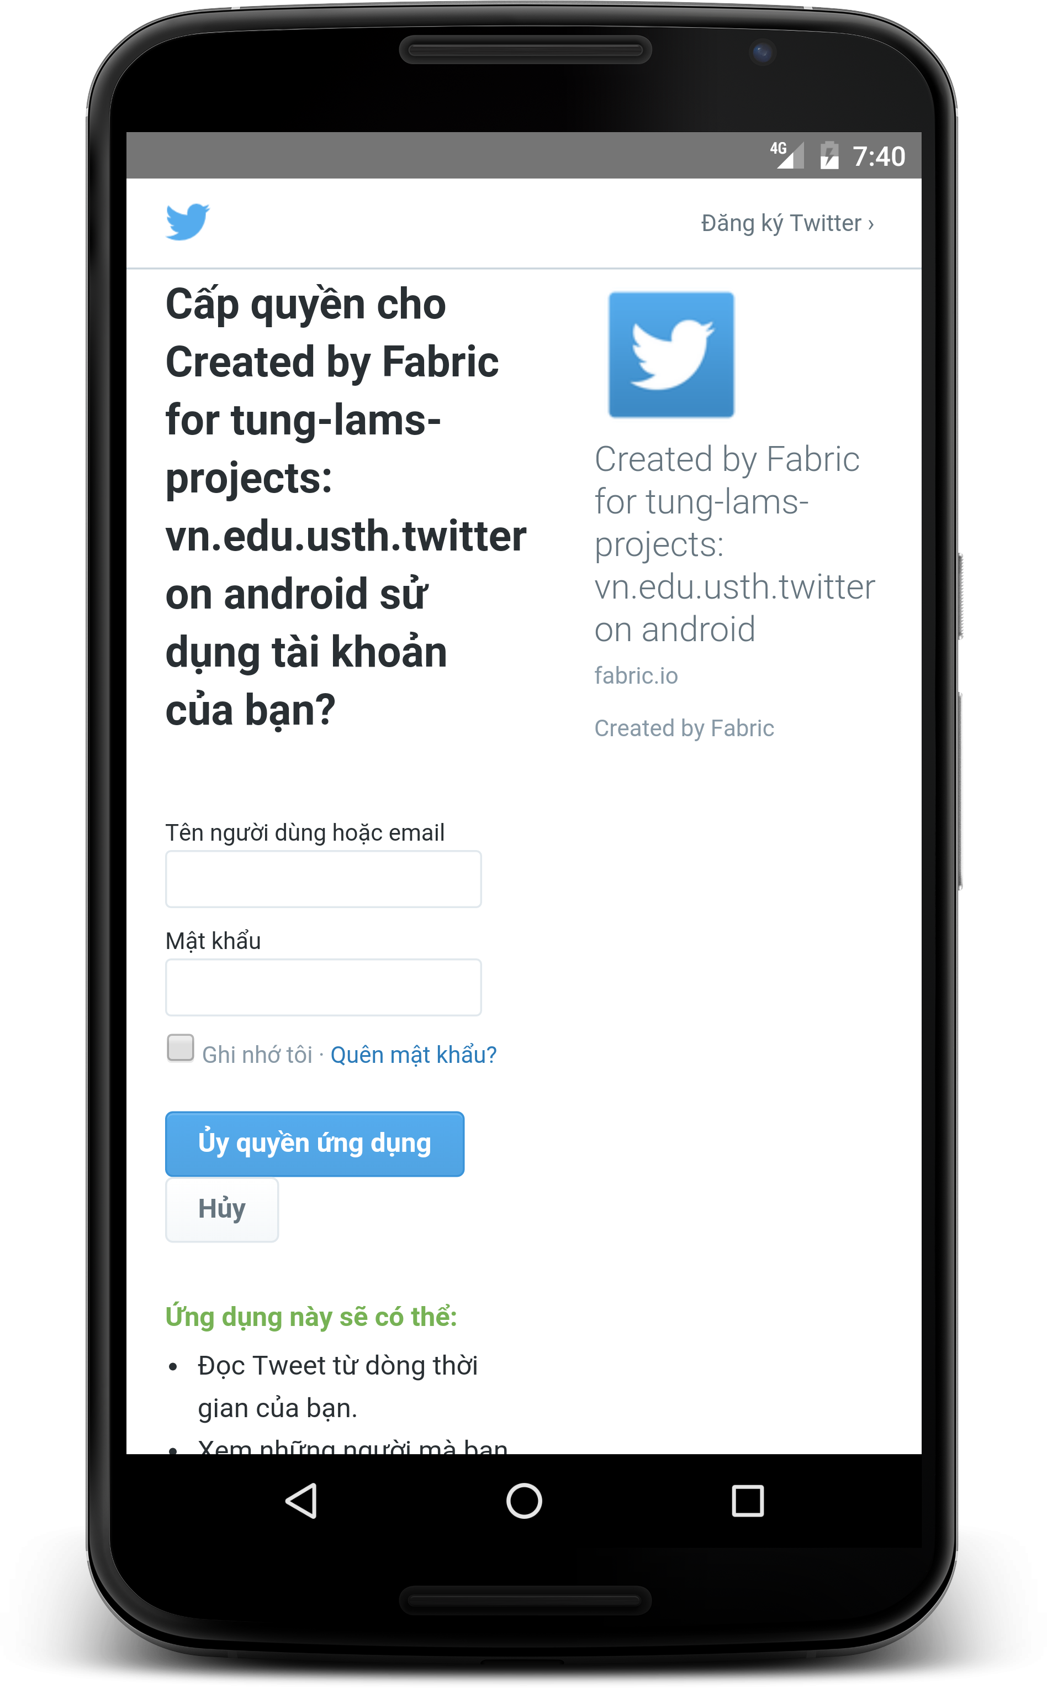
Log in activity
Confirmation from real twitter company
Enter twitter id/password to continue
User can also sign up in this page

Slide 10
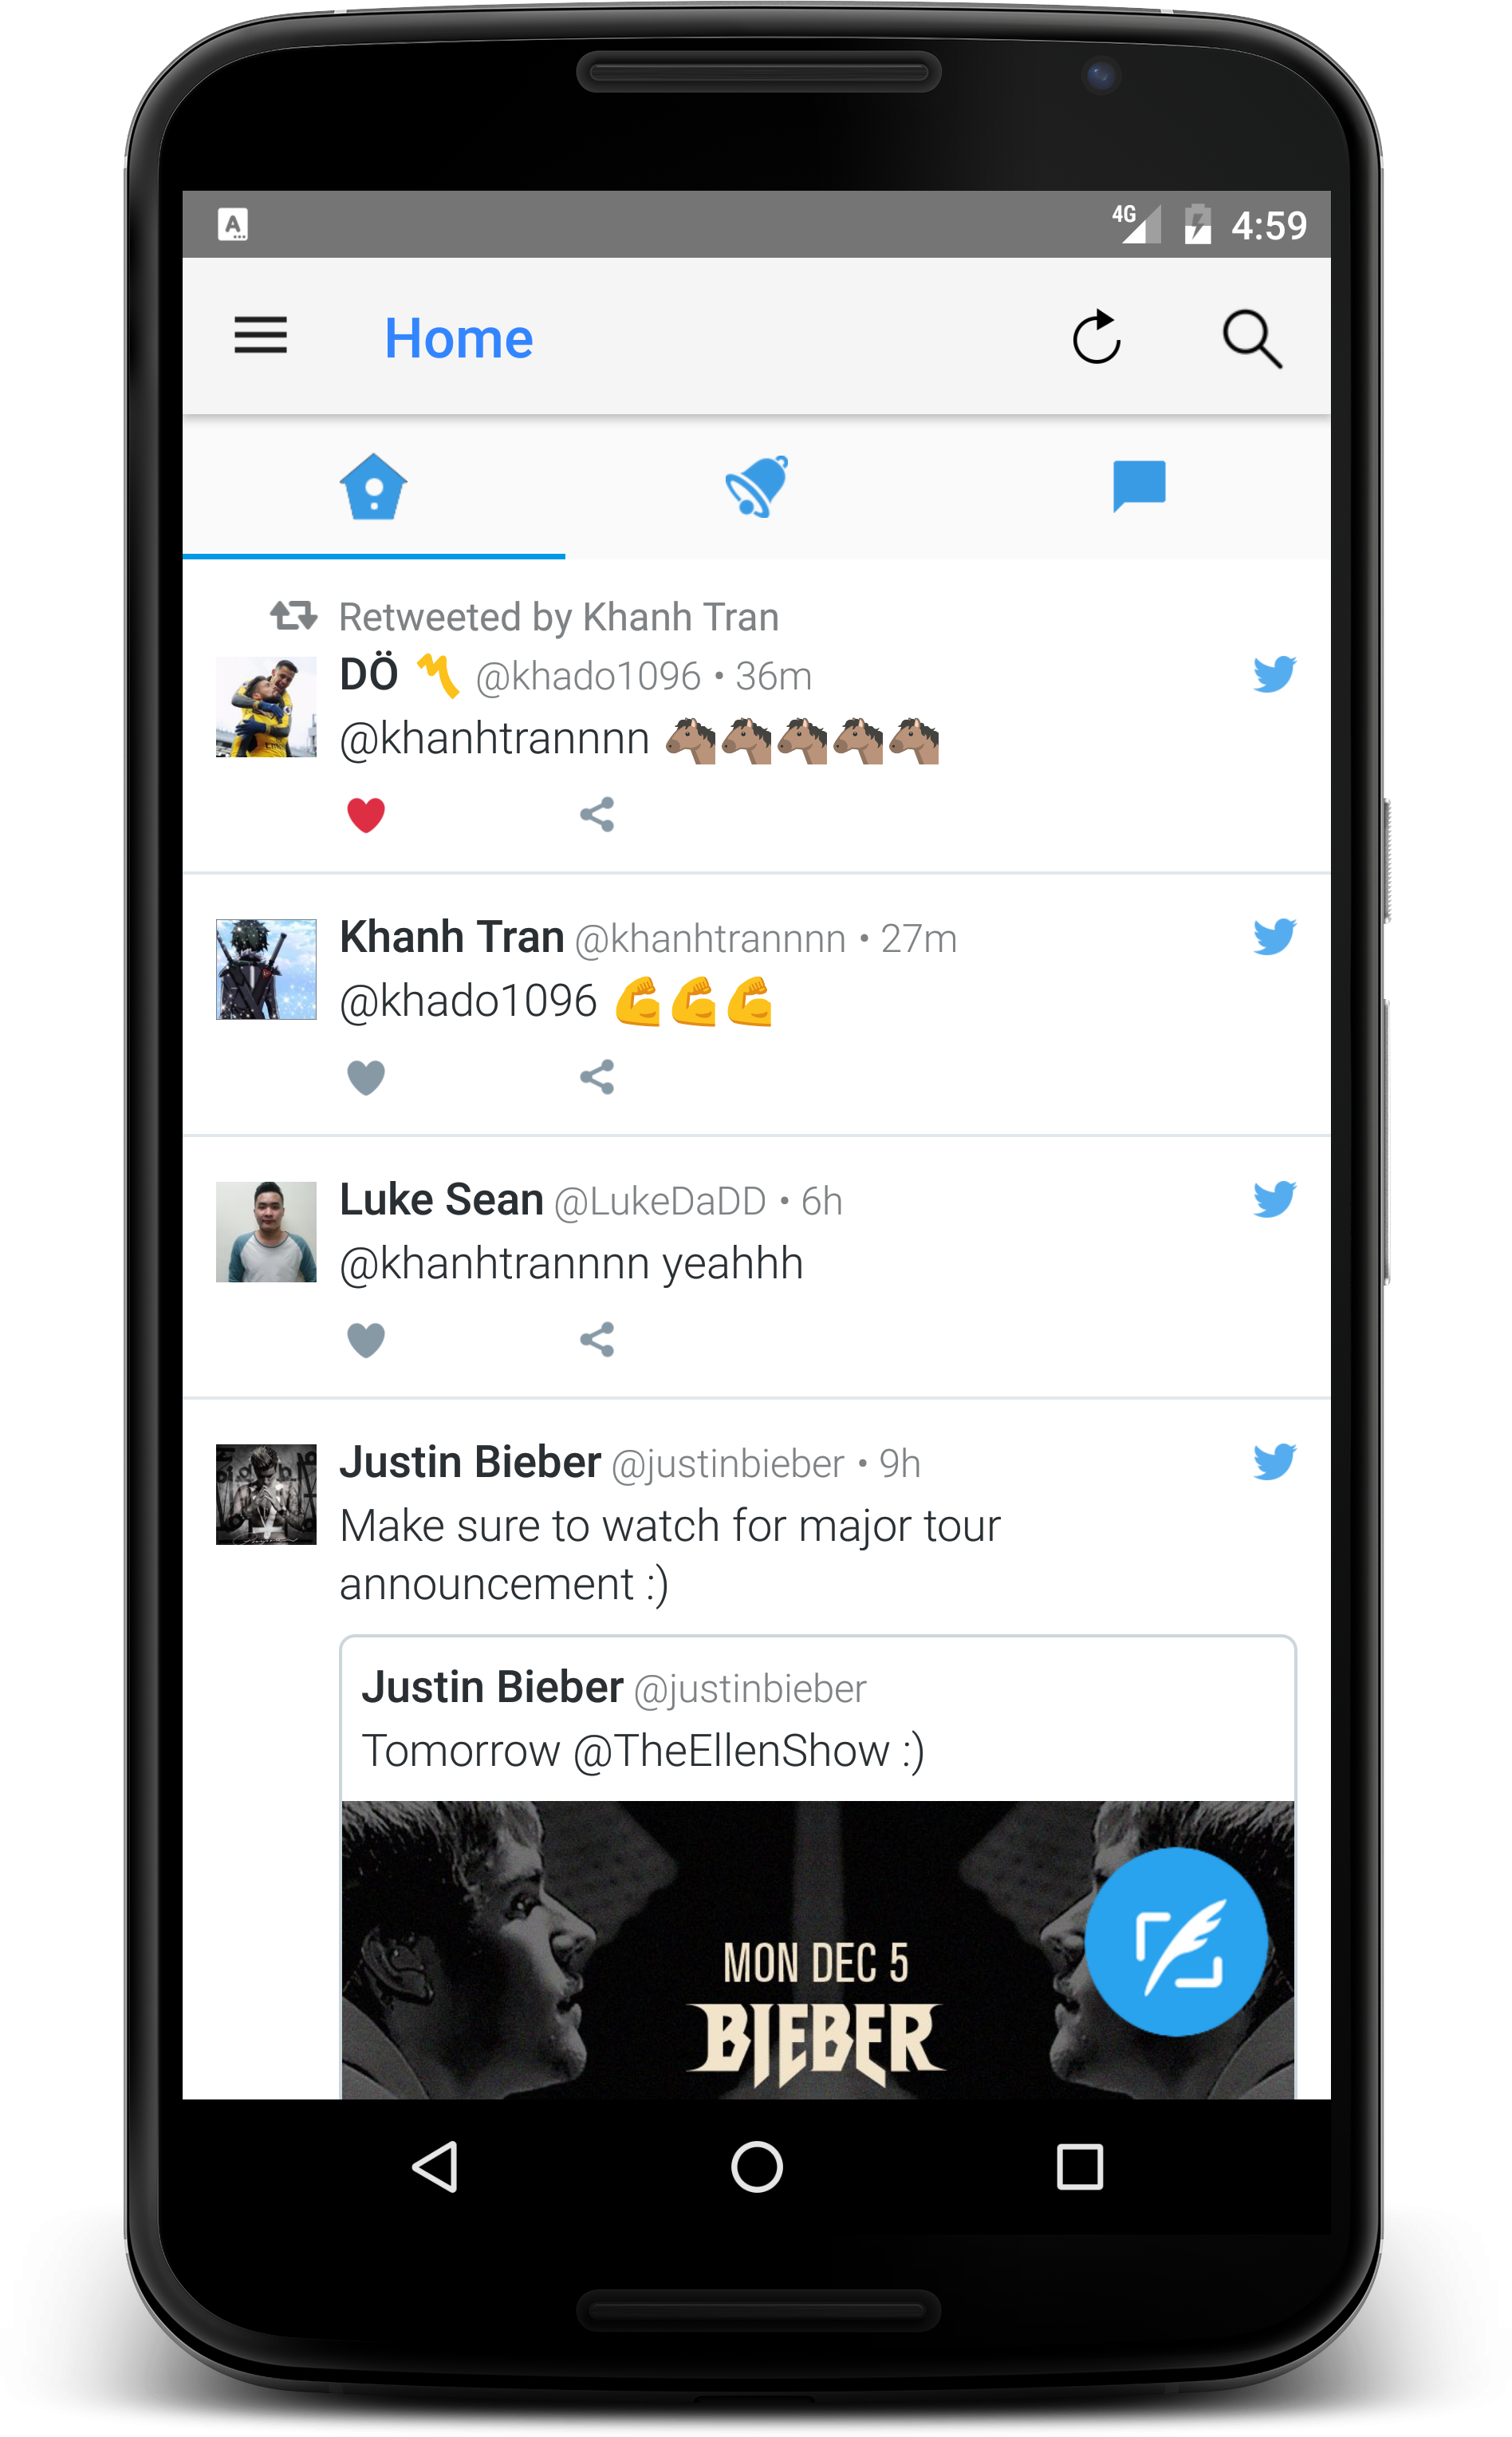
Twitter Activity – Homes
Show the most recent tweets of your following users.
2 basic functions:
Like
Share

Slide 11
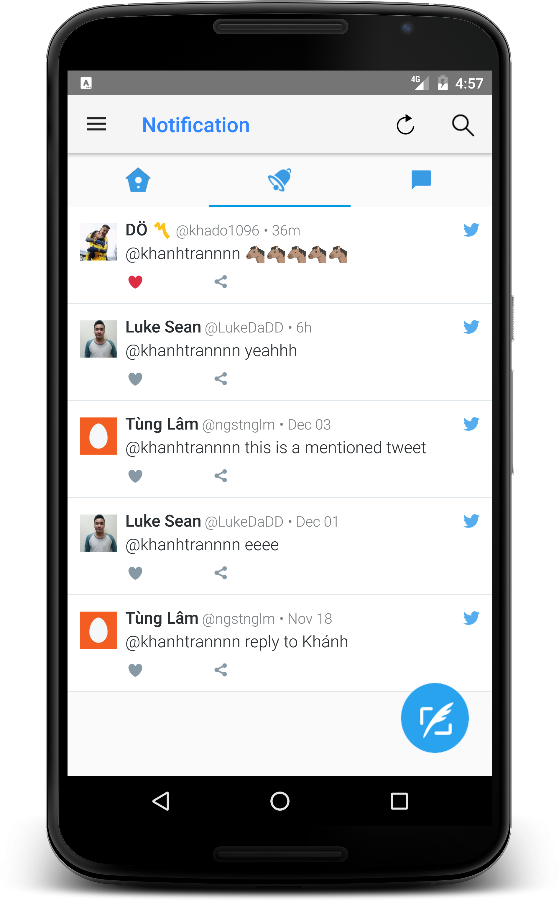
Twitter Activity - Notification
Show tweet, new follows that are related to current user

Slide 12
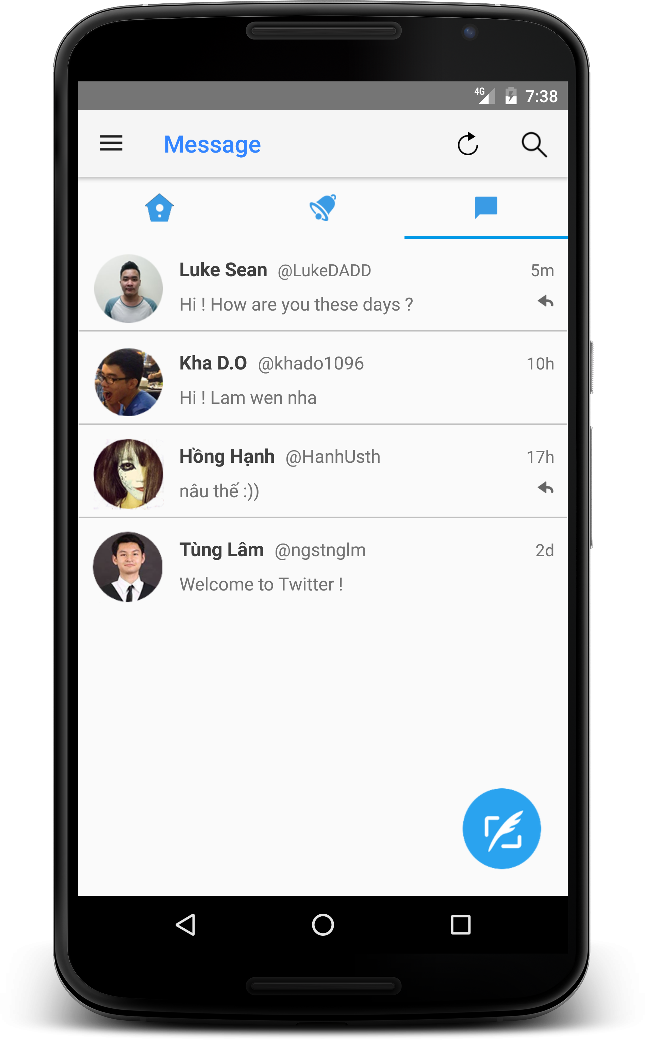
Twitter Activity - Message
Show private messages of current user with other users

Slide 13
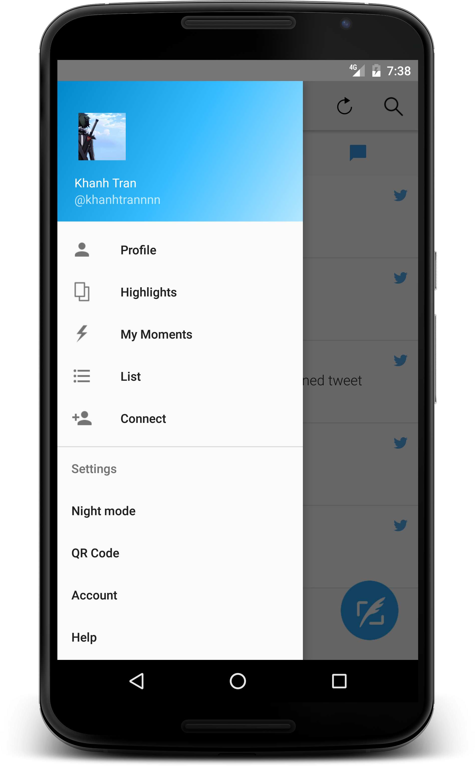
Navigation drawer

Slide 14
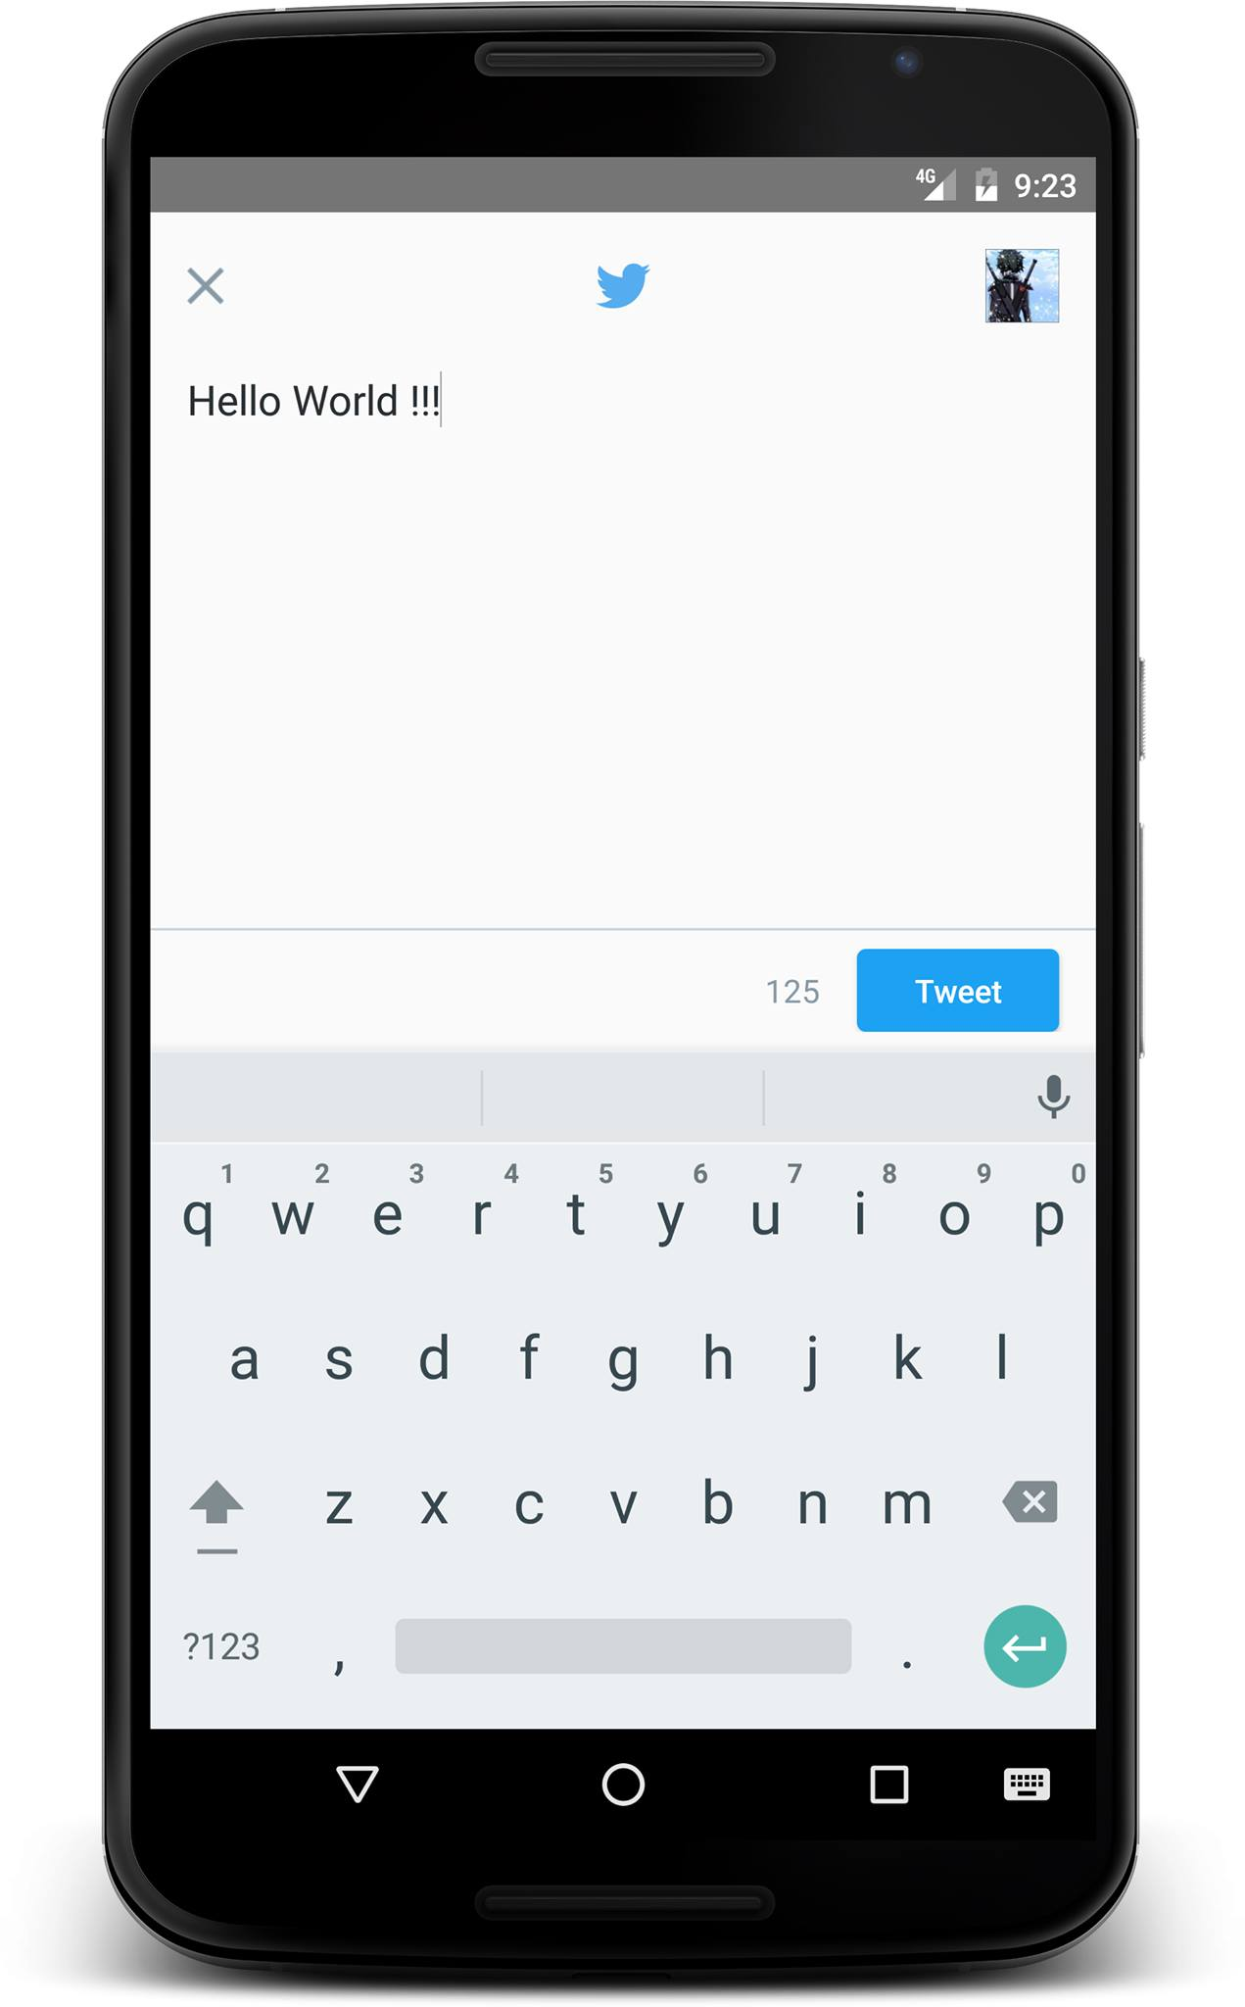
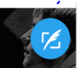
Compose new tweets
Press the button at bottom right of the screen

Slide 15
Optimization
Refresh button
Remove redundant images => less laggy when scrolling
Splash screen while loading

Slide 16
Demo Time

Slide 17
Conclusion
We want to talk about our improvements compar to the last work

Slide 18
Improvements
Load real data from twitter
Compose new tweets directly
Better performance
Better looking UI

Slide 19
Thank you for listening!

